Slide 1





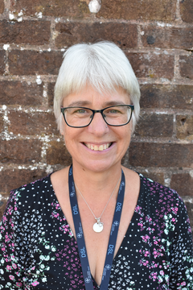

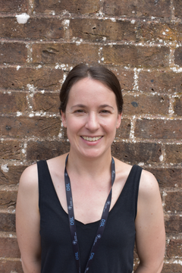
THE CRANLEIGH CHRONICLE
SCHOOL NEWSLETTER
Thursday 11 December 2025
Dates for the diary:
Quick News:
New Ofsted framework and what it means for parents:
New Ofsted report cards and grades: a guide for parents
19 December- Dress in Christmas Mufti 13:15 end of day
5 January- INSET
6 January – INSET
7 January- Return to school – Welcome back!
PAGE 12
Christmas Message from the SLT
As we approach the end of this term, we would like to take this opportunity to express our heartfelt thanks for your continued support throughout the year. Your partnership in nurturing and guiding our pupils is invaluable, and together we have helped them grow academically, socially, and spiritually.
At our school, rooted in a strong Christian ethos, we strive to reflect the values of love, compassion, and hope in all that we do. This season reminds us of the joy and peace that come through faith, and we are grateful for the sense of community that binds us together.
On behalf of all the staff, we wish you and your families a blessed and joyful Christmas. May this festive season bring you peace, happiness, and the warmth of God’s love.
Thank you once again for all you do to support our school. We look forward to continuing this journey with you in the New year!
Safeguarding
Parenting & Inclusion
Support
While Christmas is a time for celebration, we also know it can bring unique challenges for some children and families.
Safeguarding remains our top priority — even when school is closed.
Keeping Children Safe Over the Holidays
Stay Connected – Encourage open conversations with your child about how they’re feeling.
Know Where to Get Help – If you have concerns about a child’s safety or wellbeing, please reach out to the appropriate services (see contacts below).
Online Safety – Many children will spend more time online during the break. Remind them about safe internet use and encourage them to speak up if something makes them uncomfortable.
Key Contacts Over the Christmas Period
Local Safeguarding Team:
CSPA 0300 470 9100 (Monday-Friday 9am-5pm)
Out of hours 01483 517898
NSPCC Helpline: 0808 800 5000
Childline (for children): 0800 1111
Police (non-emergency): 101 | Emergency: 999
We are pleased to let you know that the school has wellbeing booklets designed to help support children with building self-esteem. If you feel your child would benefit from this resource, they are welcome to come and see Mrs Mills or Mrs Jackson to collect a booklet
If you are concerned about the safety or welfare of a child, please contact the Safeguarding Team.
Mrs T Church
HLTA/Thrive Practitioner
Deputy Designated Safeguarding Lead
Mrs J Mills
SENDCo/Head of Inclusion
Deputy Designated Safeguarding Lead
Mrs N Jackson
Assistant SENDCo
Deputy Designated Safeguarding Lead

Slide 2
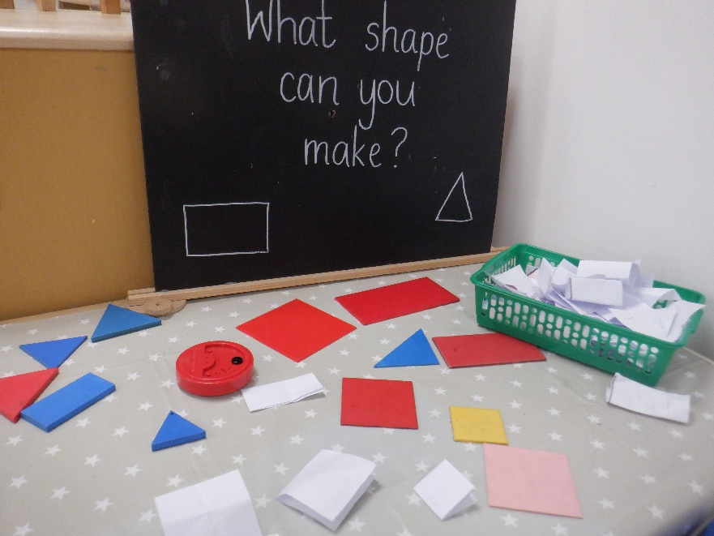
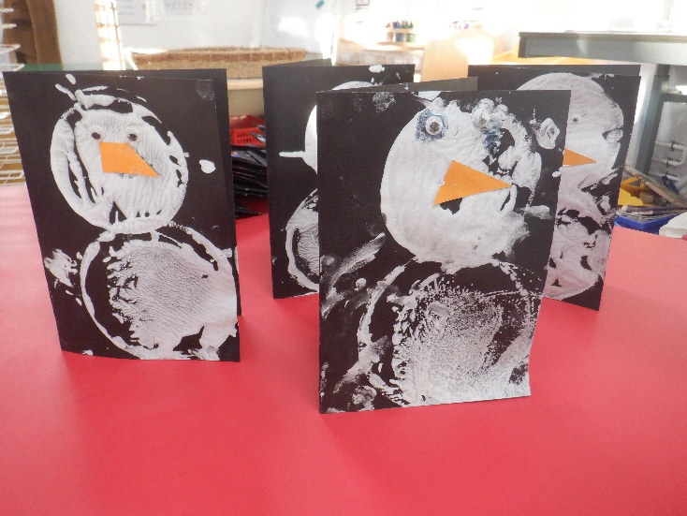
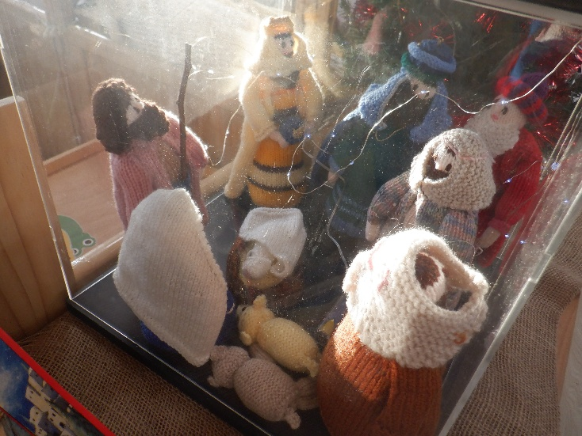


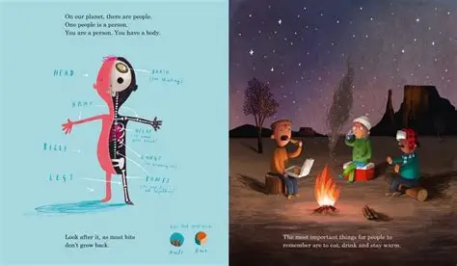
EYFS and Key Stage 1 News
In Reception we are going all out for Christmas…
Making cards and learning all about the Nativity story,
Athletics update
while keeping on top of all our usual learning too!
PAGE 12
KS1 have been working hard to prepare for the Christmas Concert. All the teachers cannot wait to see their fantastic performance next week, on Wednesday 17th December, in St Nicholas Church.
Lower KS 2 News
In Year 3 we have had a busy week learning about 2D and 3D shapes! We went on a shape hunt around the school and then created pictures using the shapes we have been looking at. We enjoyed creating patterns based on colour/number of sides.
In Year 4 have been working hard to learn their new Christmas songs ready for our concert next week! We are very excited to showcase what we have been working on.
Upper KS 2 News
This week, Year 5 and 6 have been planning and writing their own information reports on how to look after the planet and the importance of this. Year 5 have been focusing on including relative clauses to add extra information to their writing and Year 6 have been working hard to develop their ideas further using parenthesis.

