Slide 1

What we are learning
Our project for this half term is:
Let’s Explore all about families, our school community and the wider community.
We also begin to look at a mini project Signs of Autumn just before the half term break and continue this into the beginning of Autumn Term 2.
Through these projects we will cover all of the 7 areas of learning for EYFS. We will also link our Literacy and Maths to these themes where
applicable.
We are currently reading Where the Wild Things Are
and getting to know the story really well before having a
go at drawing our own pictures to tell the story.
Notes:
Could you pop in info re Cornerstones' projects and books you're reading this term

Slide 2
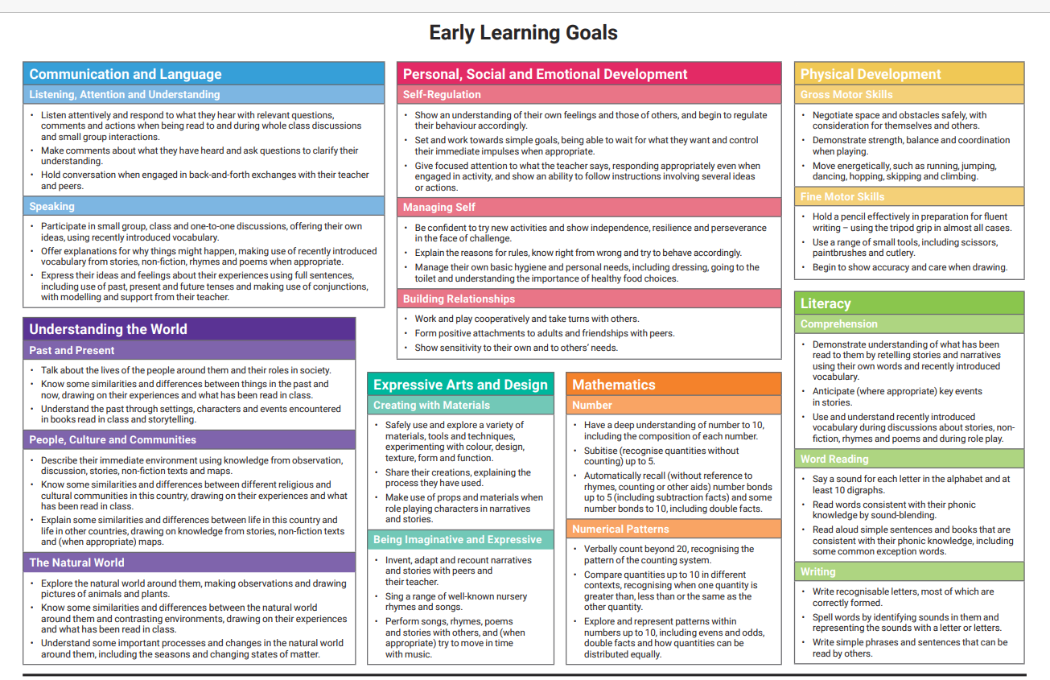
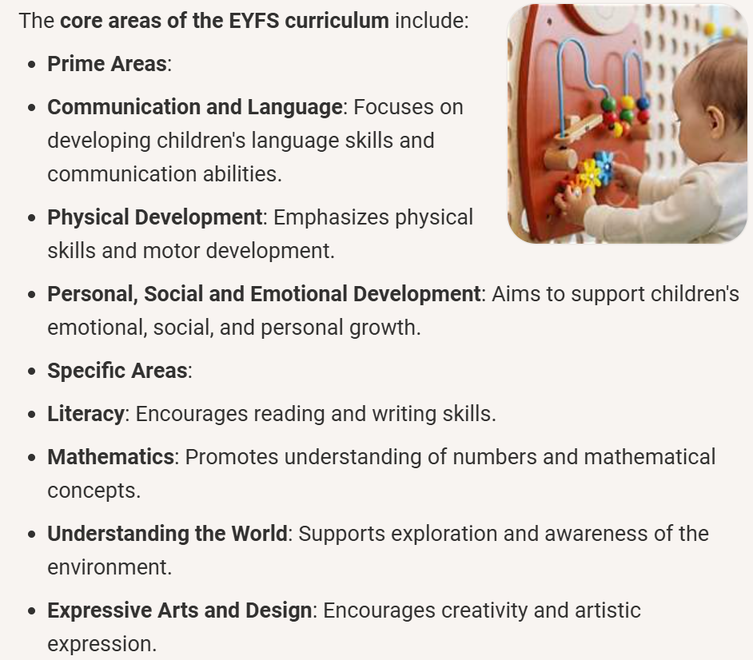
The EYFS Framework

Slide 3
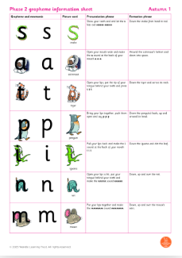

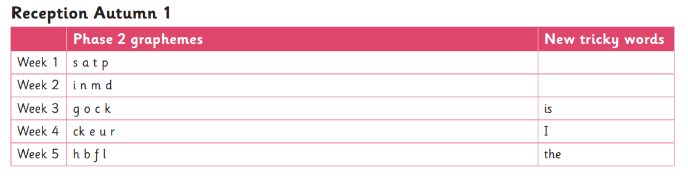
Phonics & Reading
We have begun teaching the Little Wandle Phonics Program. The children will learn to recognise and write a new letter sound every day for four days and we have a recap of all the sounds on a Friday.
Please read with your child every day. This is the most important home learning they can do in Reception. To begin with they will bring home a ‘sharing book’ which is a free choice of book that you can enjoy reading to them and discussing. They will have a Reading Record. Please sign this every time you read with your child. You do not have to write a comment every time unless you wish to.
The reading book and Reading Record must come to school every day so that an adult can read with your child at school.
We have daily phonics lessons with a new sound being taught each day. The children will come home with a sticker showing you the sound they have learnt that day. Please practice this with them at home.
Notes:
Explain Little Wandle and home reading expectations
Also Reception useful words (can you have a list and send these home with each parent). I'd like these to form part of our own baseline assessment too.
Explain there will be a phonics workshop for parents soon - date TBC - and explain it's vital they attend.

