Slide 1

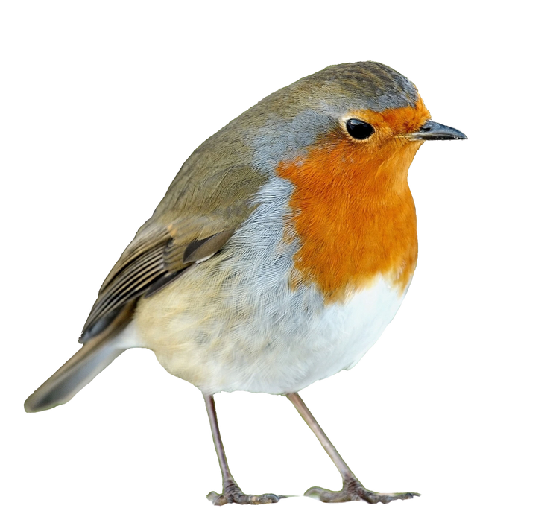
WELCOME TO RECEPTION
ROBINS
September 2026
Notes:
Explain we will email the PPT at the end of the week.

Slide 2
Meet the Team
Mrs Conisbee – Tuesday to Friday
(Class Teacher)
Mrs Baker – Monday, Tuesday, Thursday, Friday
(Teaching Assistant)
Miss Curry – Monday and Friday
(Class Teacher)
Wednesday
(Teaching Assistant)
Notes:
Explain you work Tues-Fri and Mrs Church teaches Mondays

Slide 3
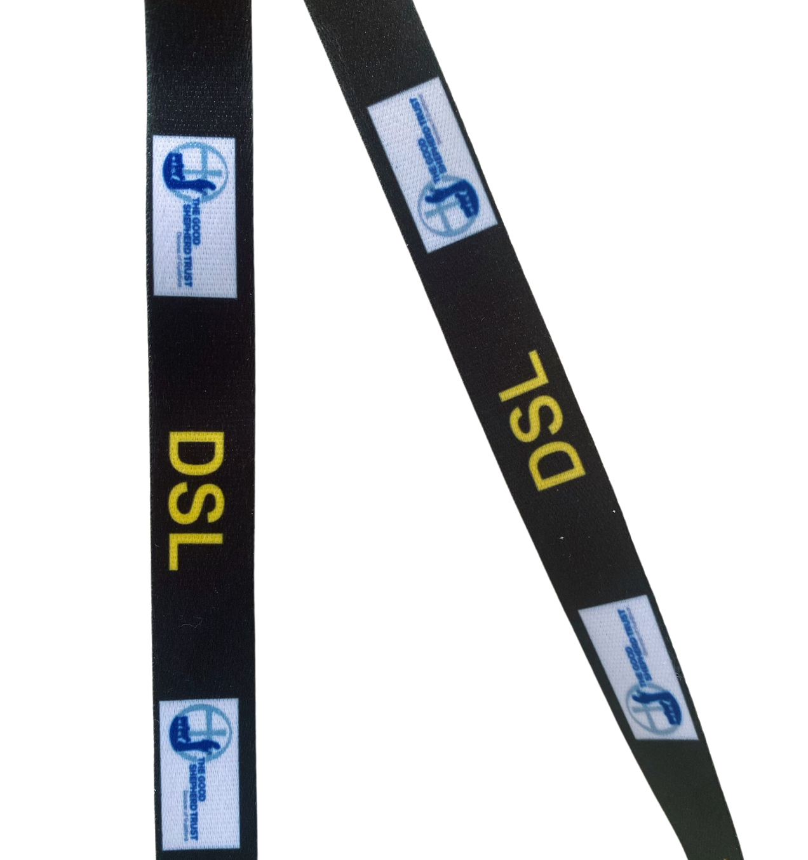
Safeguarding
Worried about a child?
Sam Clark: DSL, Headteacher
Tessa Church: DDSL, Pastoral Lead,
Thrive Practitioner
But of course all adults in school are here to support you and your child so do feel able to approach us with anyr concerns.
Notes:
DSLs wear the black lanyards.

Slide 4
8:35-8:50AM
GATES OPEN
12-12:45PM
LUNCH
3:20PM
HOMETIME
FRIDAY – come to school wearing PE kit. Please remove earrings.
THE SCHOOL DAY
Notes:
PE:
Chn come to school in their kit and they wear it all day.

Slide 5

UNIFORM
Polo shirt (logo preferred)
NO shirts or ties anymore
Spare Clothes​
We play outside in the water, sand and the mud kitchen every day.We have aprons and wellies but we do sometimes get wet. ​
Please make sure your child has a change of clothes in their bag each day to change into in case it is needed.​
​
Black school shoes
Trainers ONLY on P.E. days
NO boots at all, including UGGS
Stud earrings only (1 pair)
NO hoops, necklaces or bracelets
Our Uniform Policy is on our website
Notes:
Chn MUST bring a coat to school when the weather requires it.
EVERYTHING must be named!!!
NO earrings on PE day - these will be taped over if worn

Slide 6
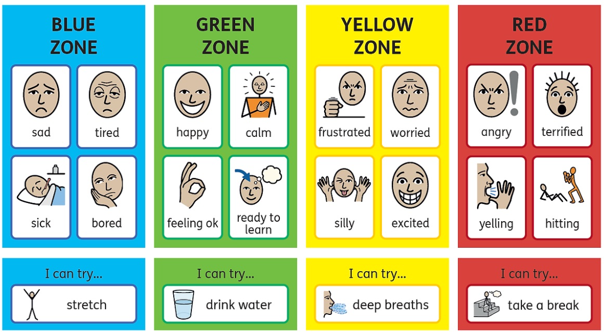
Zones of Regulation

Slide 7
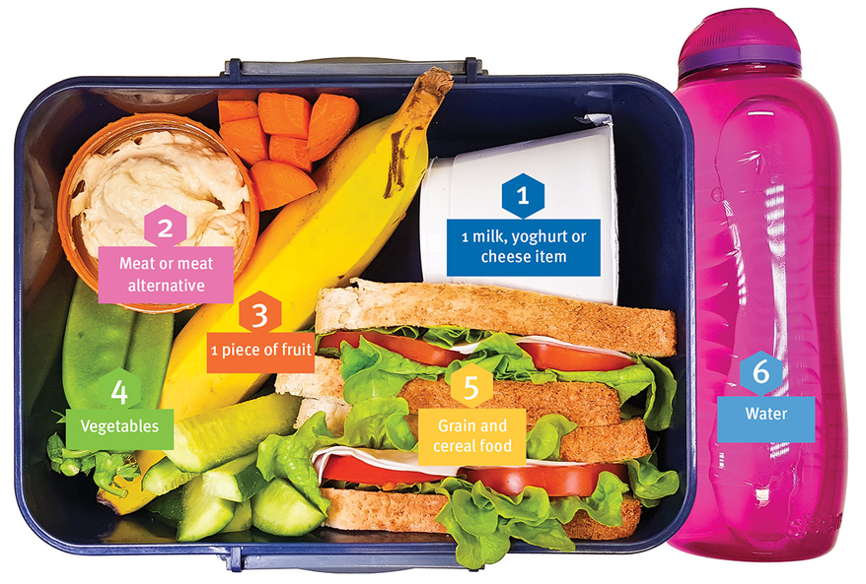
NO sweets/cakes
NO nuts or nut products
Food
We are a healthy eating school.
We provide a free fruit or vegetable snack every day in the morning. Children do not bring their own snack from home. Each day there is a selection on 2-3 sncaks to choose from. We really encourage children to have a try of a variety of different fruits and vegetables.
School dinners can be ordered via Scopay. There are 4 choices each day.
Water bottle
NO squash, juice or fizzy drinks
Notes:
No sweets or cakes for birthdays (a book donation for our library instead).
Chn need to bring in a NAMED water bottle (NO squash, juice or fizzy drinks under any circumstances).

Slide 8
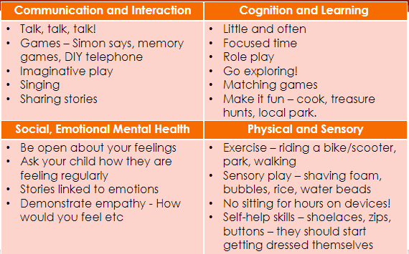
How you can help
Please make sure that every item of clothing is named clearly (including even gloves and socks). We encourage independence but jumpers are often taken off and do not always make it on to pegs.

Slide 9


KEEP IN TOUCH
www.cranleighprimary.surrey.sch.uk
01483 273286
@cranleighpri
info@cranleighprimary.co.uk
Newsletter - emailed every Friday
On the website

