Slide 1

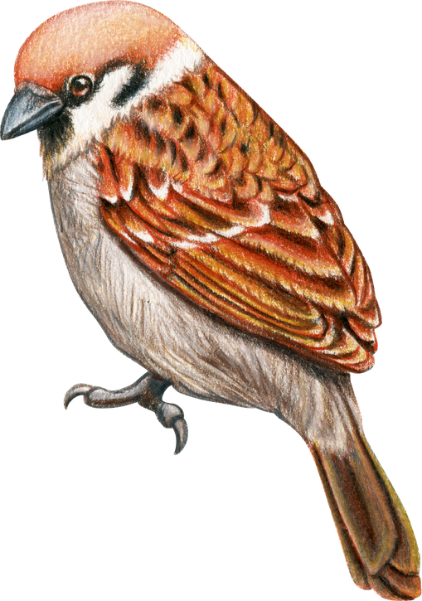
WELCOME TO YEAR 1
SPARROWS
September 2026
Notes:
Explain we will email the PPT at the end of the week.

Slide 2
Meet the Team
Mrs Khan
(Class Teacher)
Mrs Smallpeice (Teaching Assistant)

Slide 3
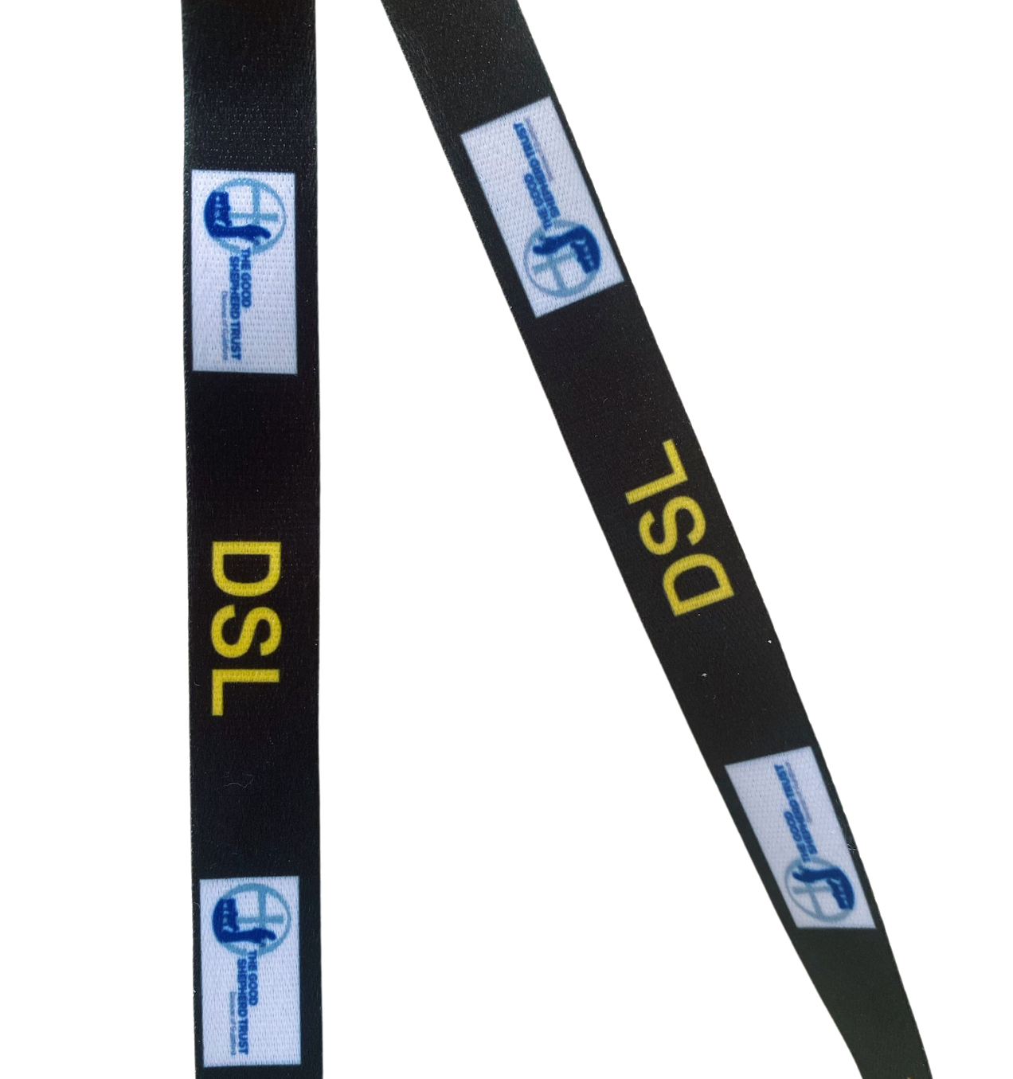
Safeguarding
Worried about a child?
Sam Clark: DSL, Headteacher​
​
Tessa Church: DDSL, Pastoral Lead, ​Thrive Practitioner
Notes:
DSLs where the black lanyards.

Slide 4
“The world is run by people who show up.”
(Anon)
Notes:
This is the start of our attendance expectations.

Slide 5
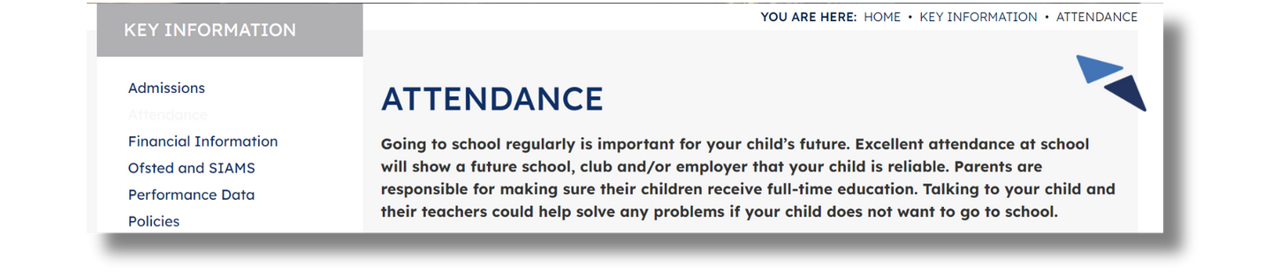
Attendance Expectations
Children must attend regularly.
Children must arrive on time.
If your child is absent as a result of illness, phone before 09:00am on 01483 273286 on the first day of absence and each subsequent day to let us know the reason.
If your child is absent due to a medical/dental appointment, email one of the following either before or after (within 5 working days) their absence in order for the absence to be authorised:
A signed/stamped letter, appointment card, text or email dated to the time of the medical/dental appointment.
Notes:
SLT will carry out unannounced home visits if school cannot get hold of you.
Fines will be issued if supportive measures to get your child attending regularly do not work.
Term time leave will only be granted in exceptional circumstances. There is an online form to complete. We will not accept paper forms.
All info can be found on our website (address at the end).

Slide 6
8:35-8:50AM
GATES OPEN
10:20-10:35AM
BREAK
12-12:45PM
LUNCH
MONDAY
THURSDAY
3:20PM
HOMETIME
THE SCHOOL DAY
Notes:
PE:
Chn come to school in their kit and they wear it all day.

Slide 7

UNIFORM
Polo shirt (logo preferred)
NO shirts or ties anymore
Our Uniform Policy is on our website
Black school shoes
Trainers ONLY on P.E. days
NO boots at all, including UGGS
Notes:
Chn MUST bring a coat to school when the weather requires it.
EVERYTHING must be named!!!

Slide 8
Home Reading
Notes:
How does it work - is there a timetable - books in bookbags every day?
What are the expectations (reading records, days etc)

Slide 9

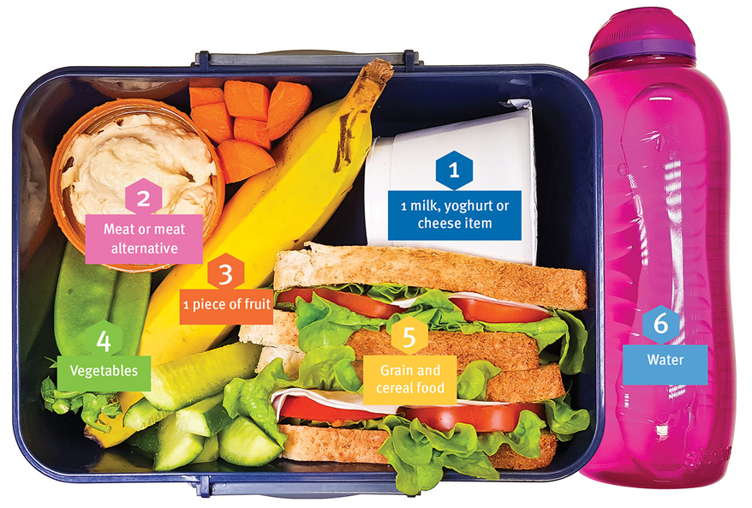
NO sweets/cakes
NO nuts or nut products
Food
Healthy Packed Lunches
Water bottle
NO squash, juice or fizzy drinks
Notes:
No sweets or cakes for birthdays (a book donation for our library instead).
Chn need to bring in a NAMED water bottle (NO squash, juice or fizzy drinks under any circumstances).

Slide 10

Paying for anything
We are not permitted to accept cash.
Everything must be paid for via SCOPAY.
Notes:
See the office if you need help getting set up on SCOPAY.

Slide 11


KEEP IN TOUCH
www.cranleighprimary.surrey.sch.uk
01483 273286
@cranleighpri
info@cranleighprimary.co.uk
Newsletter - emailed every Friday
On the website

